Slide 1
CPSC 315 BI Technologies
Tableau Demo and Assignment

Slide 2
HW #3 Details
Due Monday, 2/17, by 5:00 pm
Yes, it is a holiday—data never sleeps
Submit your PowerPoint slides via GitHub Classroom
Assignment invitation: tbd
Save your Tableau work as a packaged workbook and include the .twbx in your submission
This presentation contains
Slides used during in-class demo
Specific instruction for the assignment

Slide 3
The story remains the same…
You are a real estate professional getting ready for a meeting with an important client. Your client is moving from across the country and wants to understand more about the homes for sale in a particular city. Your job is to produce Tableau content that facilitates an investigation into the current state of the real estate market. Ultimately you will be telling a story that makes specific recommendations for your client.
Feel free to create a persona of your client
A young, price-conscious couple with three children, or
A single executive looking for an urban condo, or
An investor looking for bargain properties to fix-up and flip
Or, whatever you choose
Be sure to introduce your client in your presentation to provide context for your recommendations

Slide 4
Getting the Data
You can start with the final .xlsx from HW1
You can also start with a .csv but be sure you have 5 digit zip codes available
Or start over with a fresh redfin.com download
Or, if you are bored/done with real estate data you can hunt down a dataset of your choosing
This option will require you to achieve similar or greater complexity in data, technical work, and story sophistication
Your chosen data must include location information since you are required to have at least one map visualization
Adjust the assignment instructions so they make sense for your chosen data
Selecting this option should not make the assignment easier

Slide 5
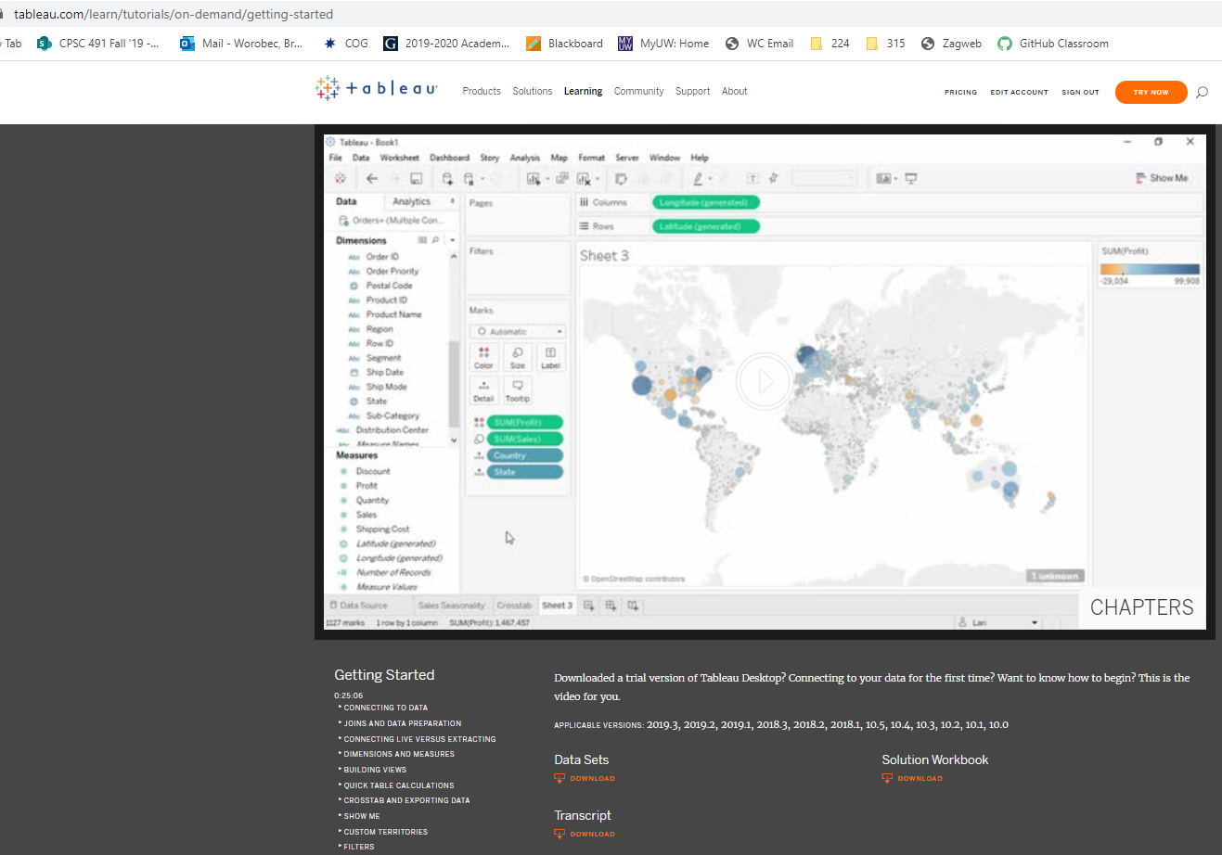
Getting Started with Tableau
A video and associated files
https://www.tableau.com/learn/tutorials/on-demand/getting-started
Global Superstore Orders
Global Superstore Returns
getting_started_transcript.pdf
getting_started_finished.twbx

Slide 6
A note on Tableau Prep
Your licensing includes Tableau Prep
It is not required for anything in this class
However…
We know that data is messy and needs preprocessing to be ready for analytics
Many BI vendors are offering tools like Tableau Prep
People with preprocessing skill are in demand
Tableau Prep would be a great skill to add to your resume

Slide 7
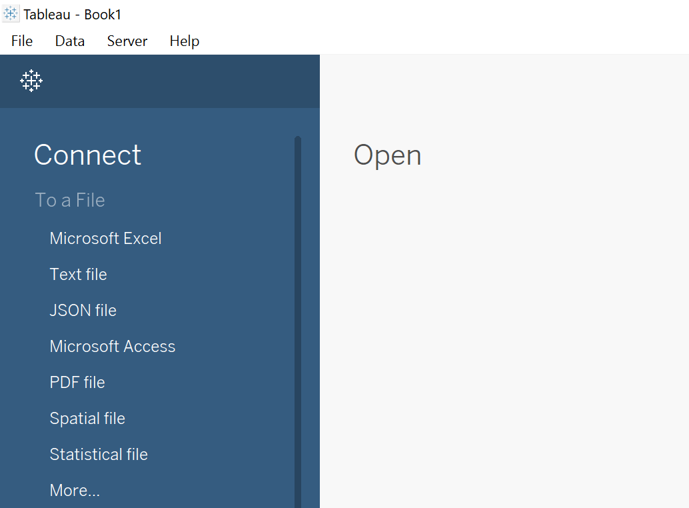
Launch Tableau
This is what you will see
You can point Tableau at either your .csv or .xlsx files
I will use the .csv version
Click ‘Text file’
Note: One of Tableau’s strengths is the ability to connect to a wide variety of data sources

Slide 8
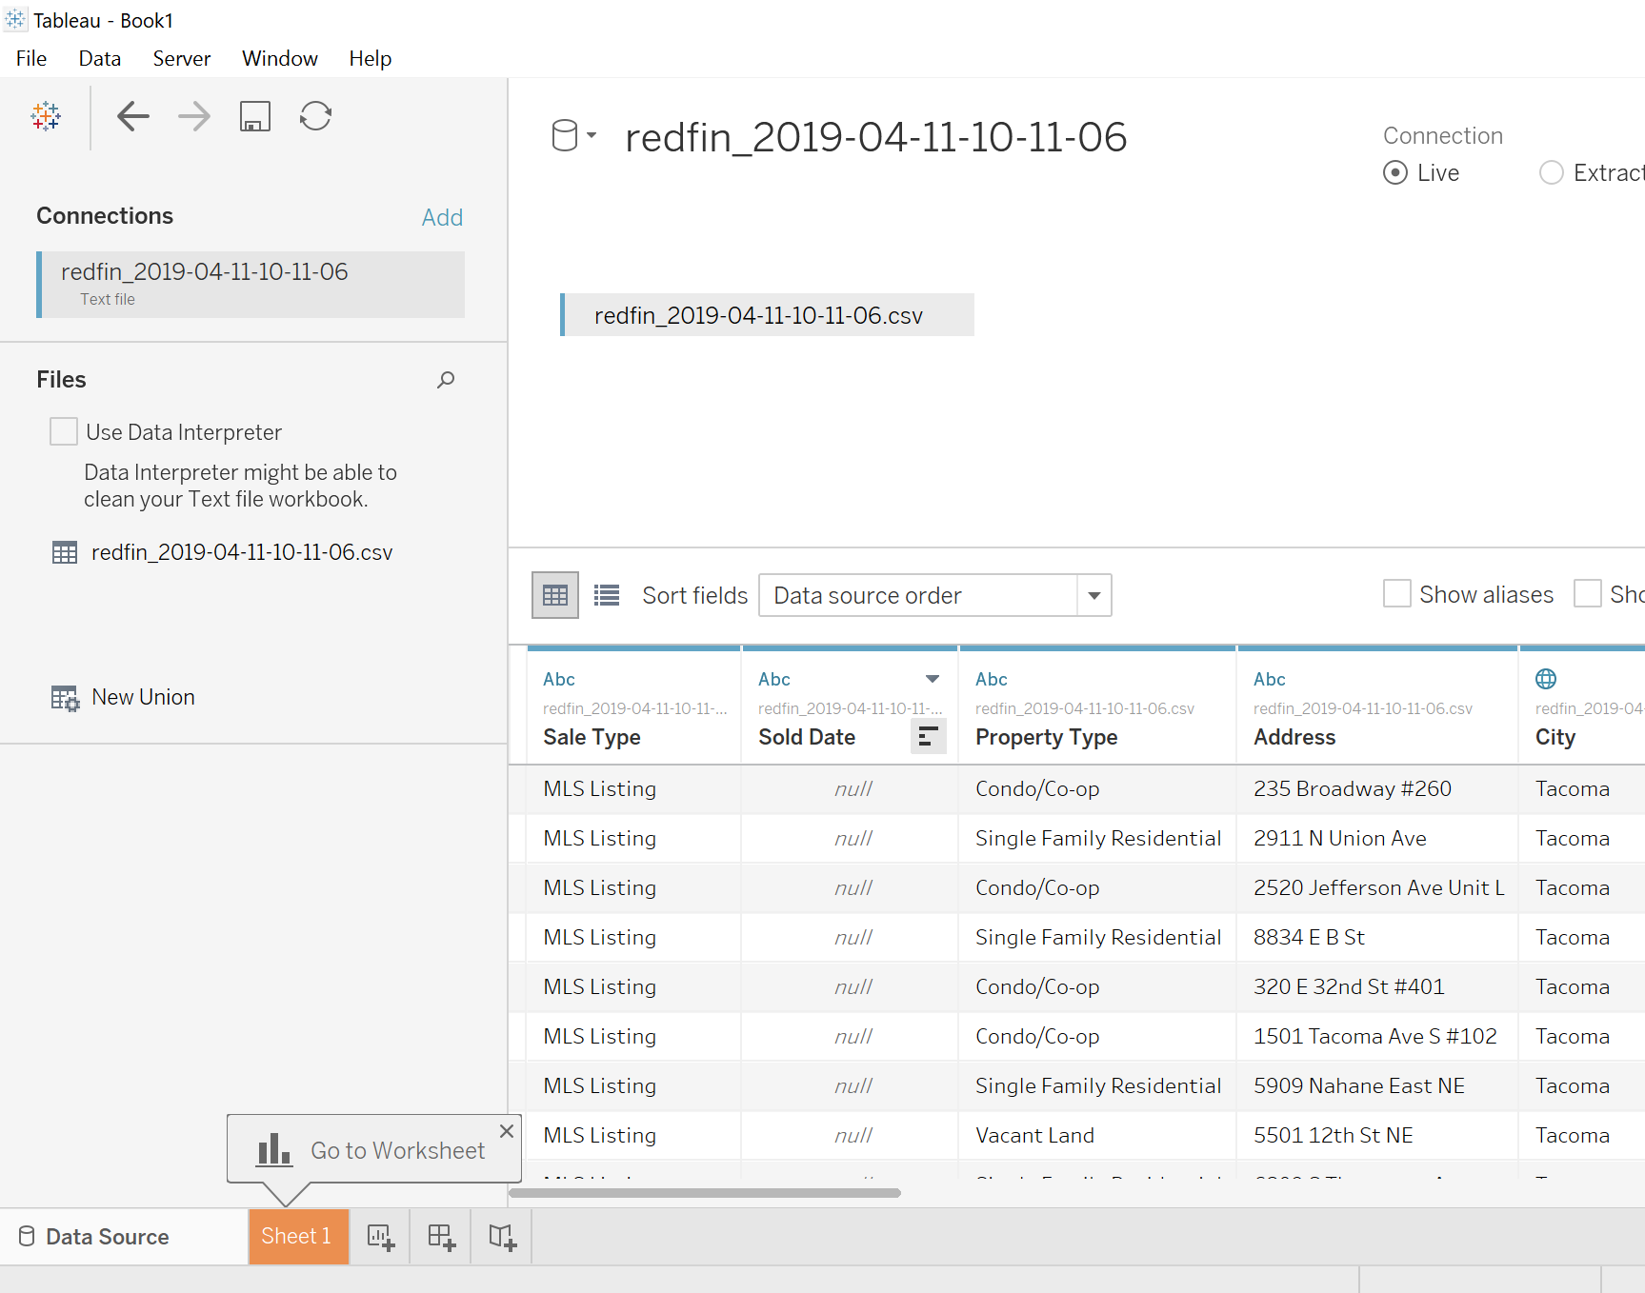
Launch Tableau
This is what you see next
Click on ‘Sheet 1’
Note these icons
New story
New dashboard
New sheet

Slide 9
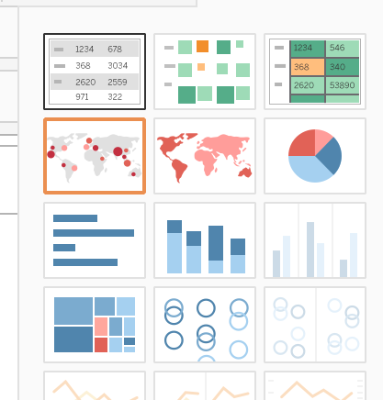
Set up “Zip Code Analysis”
Rename Sheet 1
Drag Zip or Postal Code to Rows
Drag Price to Columns
Change to Average of Price
Click to see Data

Slide 10
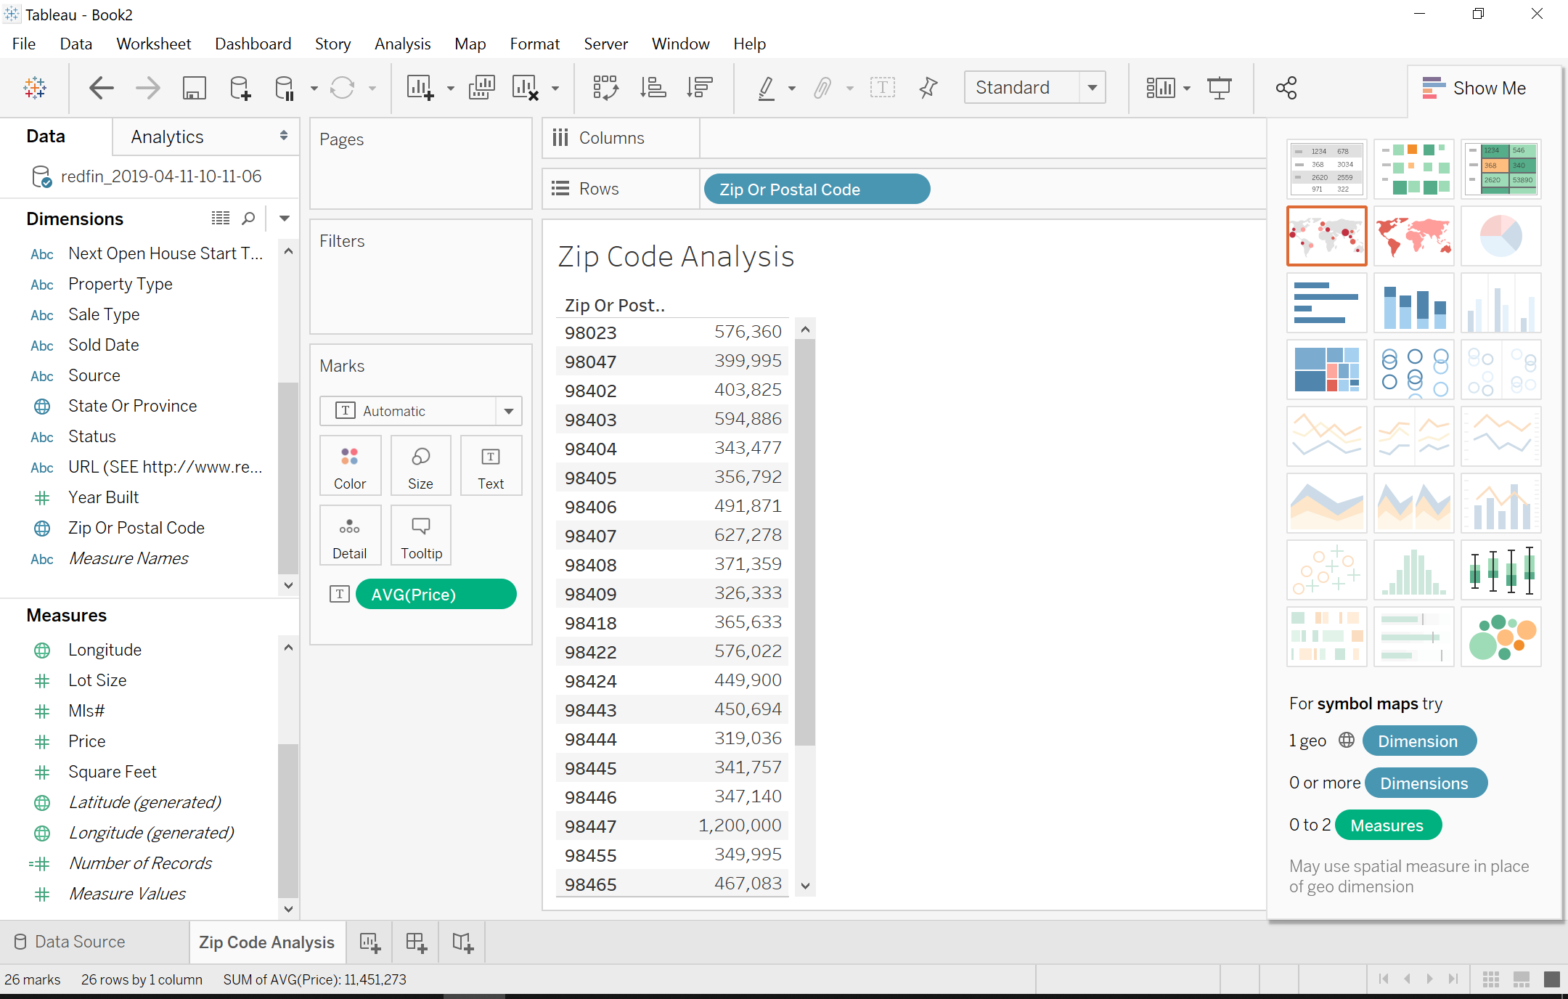
Set up “Zip Code Analysis”

Slide 11
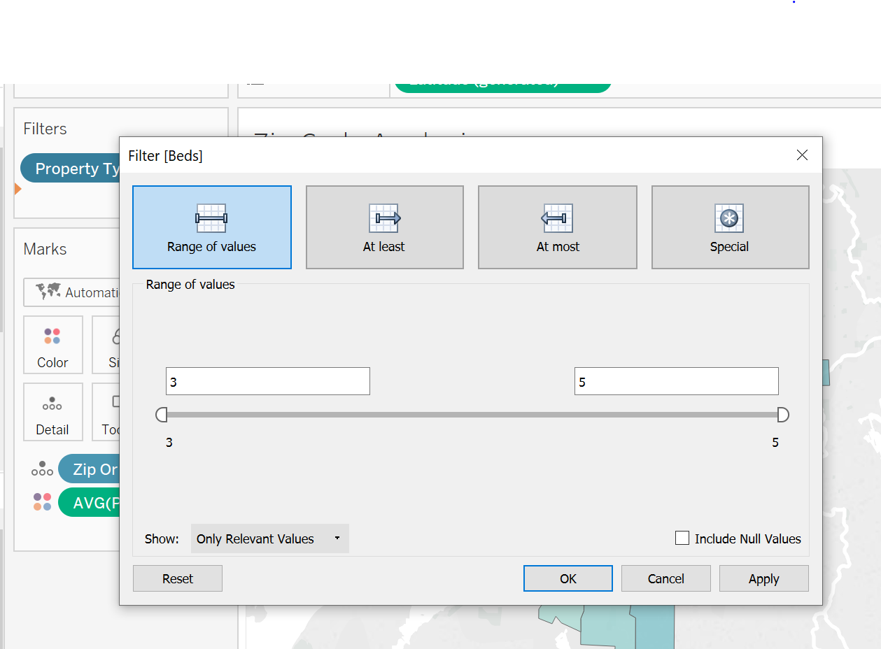
Set up “Zip Code Analysis”
More options with Filters than in Excel
Set up Beds and Baths Filters

Slide 12
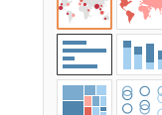
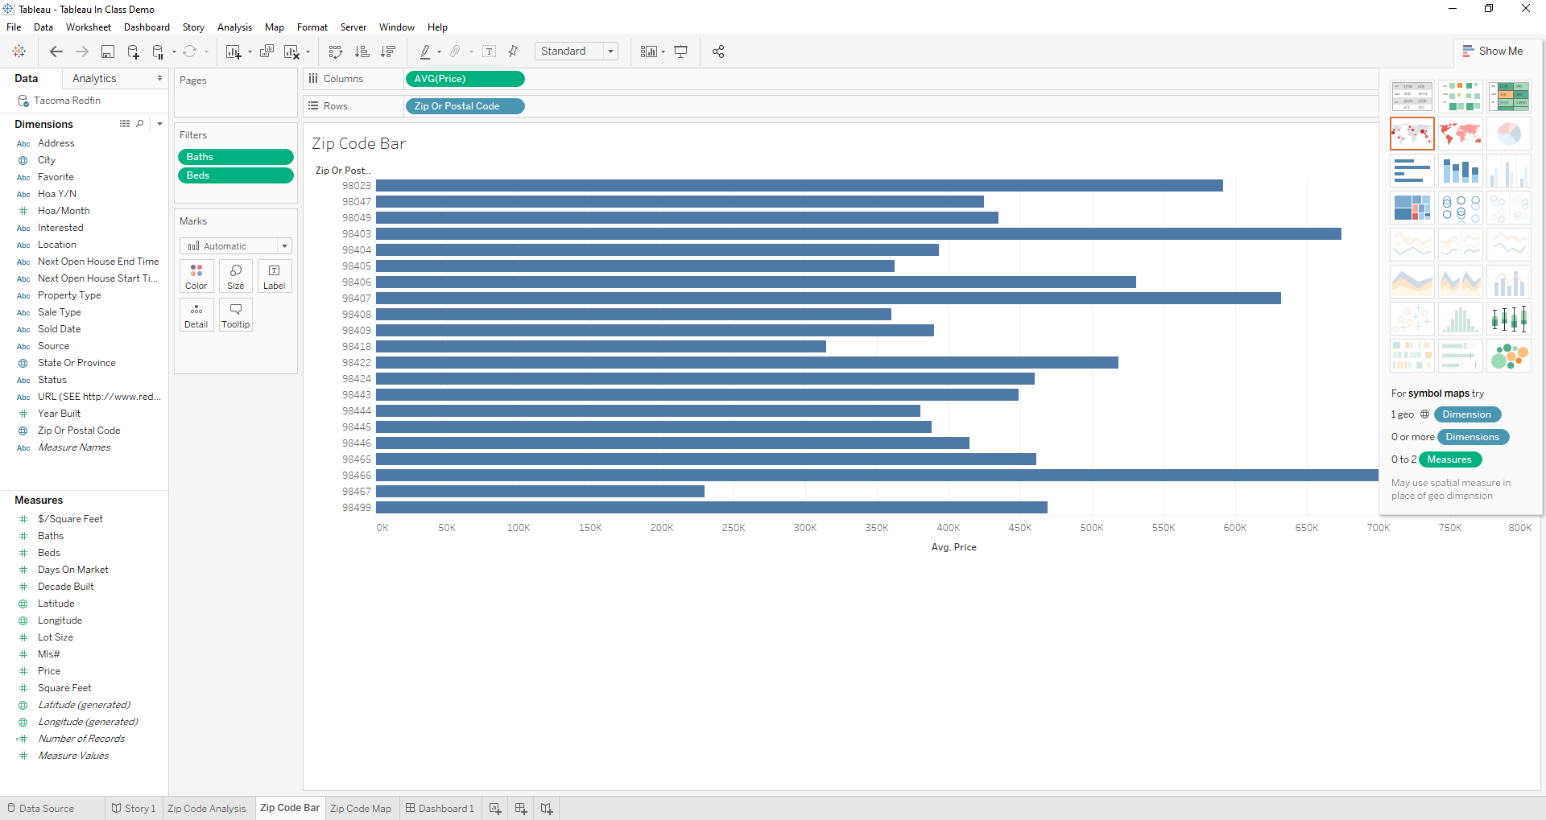
Set up “Zip Code Bar”
Duplicate your “Zip Code Analysis” sheet
Rename “Zip Code Bar”
Click on the Bar Chart icon

Slide 13
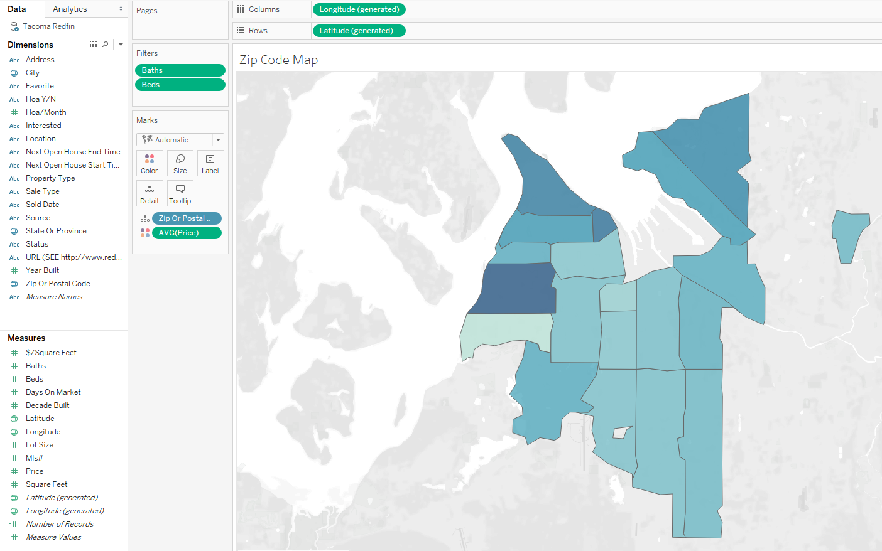
Set up “Zip Code Map”
Let’s try a map visualization
Duplicate your “Zip Code Analysis” sheet
Rename “Zip Code Map”
Click on the Map icon
See what happens when you hover over a Zip Code

Slide 14
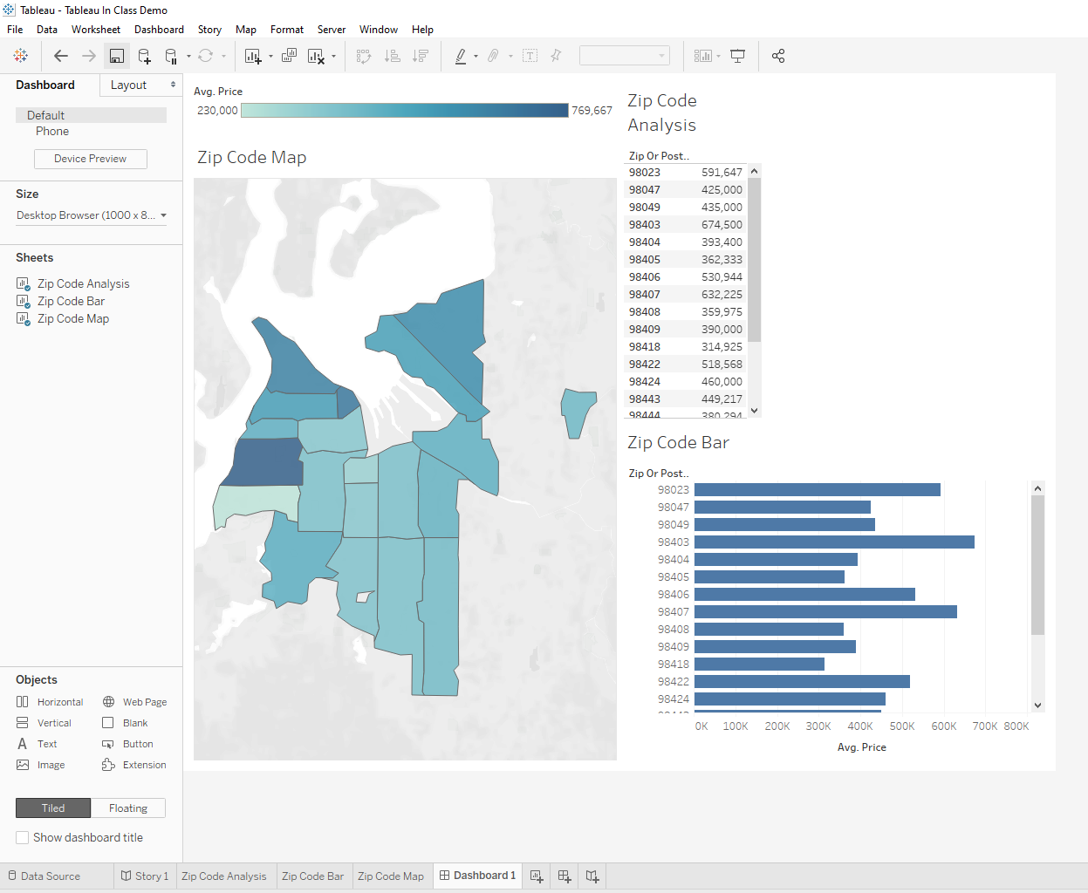

Create a new Dashboard
Click the new dashboard icon
Add Zip Code Map, Zip Code Data, and Zip Code Bar to the dashboard

Slide 15
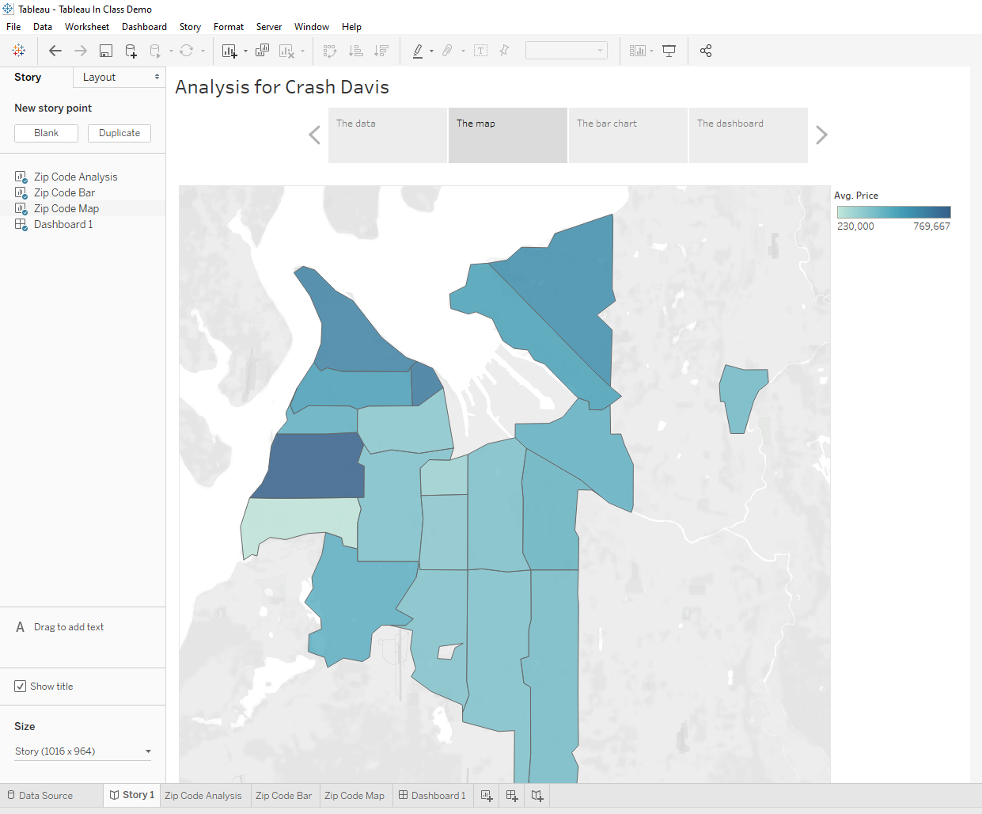
Create a new Story
Click the new story icon
Add Zip Code Map, Zip Code Data, and Zip Code Bar as Story Points
Add the dashboard as a Story Point
Add a title and captions

Slide 16
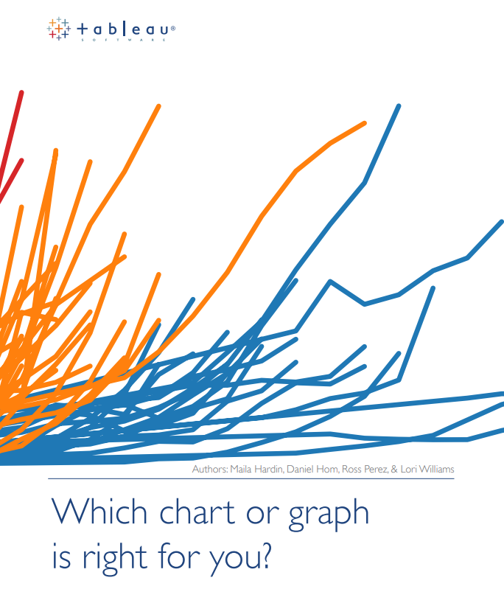
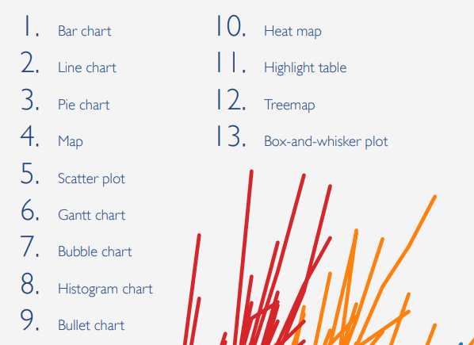
Visualizations in Tableau
Another strength of table is the wide variety of available visualizations
Check out this document for details
https://gonzagau.sharepoint.com/sites/faculty/worobec/CPSC_315_S20/Shared%20Documents/which_chart_v6_final_0.pdf

Slide 17
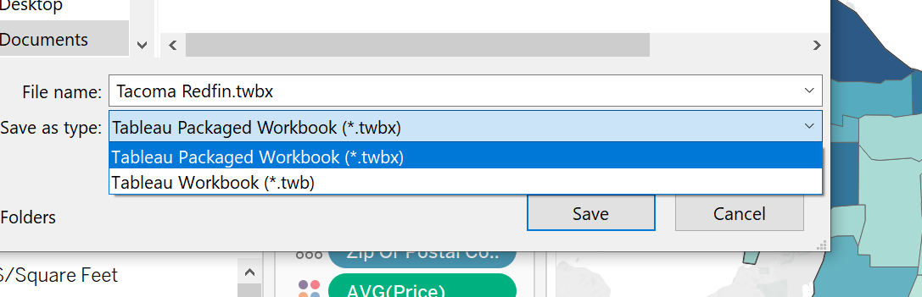
Save as a Packaged Workbook
This will include you data with the Tableau workbook
You do not need to submit your data separately

Slide 18
Homework 3 High Level Instructions
Repeat Homework #1/2 but with all data and visualization included in the presentation coming from Tableau
You are free to pick different a different city or refresh the listings from your original city
You are free to pick a different client
You are free to enhance your Homework 2 story as your technical skills and storytelling improve

Slide 19
Homework 3 Detailed Requirements
Create a single Tableau workbook for that includes the following
Sheets that represent the 4 areas of analysis done in previous homework
Zip Code, Property Type, and two of your choosing
Note that you may have multiple sheets per analysis for data and multiple visualizations
A Map visualization
A Dashboard that pulls together multiple sheets
A Story with Story Points that captures the story you will include in your finished presentation

Slide 20
Homework 3 Additional Considerations
In Homework 1 you snipped data and visualizations to include in your presentation
These snips were then interspersed with PowerPoint text to tell your story
Tableau includes Dashboard and Story functionality
Some argue that a Tableau workbook should not require a separate slide deck and that your story should be told simply by navigating through the Tableau Story
For Homework 3 I still want a separate slide deck with snips from Tableau, but…
Strive for Story Points and a Dashboard that can be snipped in their entirety and will not need to be supplemented to form presentation slides

Slide 21
For your assignment submission
Produce a 10 slide PowerPoint deck and upload to GitHub Classroom
As before, make sure your slides both tell a story and demonstrate the requested technical work
Copy the rubric slide from this slide deck into your slides
Be sure that the rubric is the first slide and that your name in on the second slide
The rubric slide does not count as one of your 10 slides
Save your Tableau work as a packaged workbook (.twbx) and upload to GitHub Classroom
You do not need to include your data file since it will be included in the packaged workbook

Slide 22
Final thoughts
You have creative license, use it
You do not need my permission to go above and beyond what was requested
Be sure you tell a story
Support your decisions and recommendations with data and visualization
Try some visualizations you haven’t used previously—expand you pallet
Numerous how-to videos are available online
Do a search for “Tableau video” if you get stuck
Tableau is an excellent resume and interview item
Use this assignment to build a skill for a lifetime

Slide 23
HW #3 Feedback/Rubric Score ____/20
Complete requested technical work in Tableau: _____/10
4 areas of analysis (zip code, property type, plus two additional)
A Tableau Dashboard
A Tableau Story
A map visualization
A Packaged workbook (.twbx file)
Professional presentation and analysis: _____/10
Client introduced
Presentation tells a story
Story improved over HW2
Final recommendation supported by data and visualizations
Professional slides

